Slide 1
Name: DHANUSH E

Slide 2
PROJECT TITLE:
Title:
Image Recognition In Deep Learning

Slide 3


AGENDA:
PROBLEM STATEMENT
PROJECT OVERVIEW
WHO ARE THE END USER?
YOUR SOLUTION AND ITS VALUE PROPOSITION
THE WOW IN YOUR SOLUTION
MODELLING
RESULTS
3/21/2024 Annual Review

Slide 4

PROBLEM STATEMENT
The challenge is to create robust deep learning models for user image recognition, accurately identifying and interpreting images for applications like facial recognition, object detection, and gesture analysis. This requires addressing issues such as data quality, model complexity, and interpretability. Ethical considerations regarding privacy, bias mitigation, and fairness in algorithmic decision-making are also crucial for responsible deployment. Balancing accuracy, efficiency, and ethical standards is essential to ensure user trust and privacy while leveraging the benefits of image recognition technology for intuitive and personalized user experiences in various domains.

Slide 5

PROJECT OVERVIEW:
The project involves developing an image recognition system using deep learning techniques, specifically CNNs, for user-centric applications like facial recognition and object detection. It prioritizes data quality, model optimization, and ethical considerations such as privacy and bias mitigation. Through rigorous testing and validation, the system aims for high accuracy and robustness. The project also emphasizes user experience enhancements, ensuring intuitive interactions and adhering to ethical AI standards. Collaboration with stakeholders and end-users guides development, aiming to deliver a reliable and efficient image recognition solution that enhances user trust and contributes to responsible AI deployment in various domains.

Slide 6

WHO ARE THE END USERS?
Consumers: End-users could be individuals using applications that utilize image recognition, such as photo organization apps that automatically tag and categorize images.
Security Personnel: In security systems, end-users are security personnel who rely on image recognition for tasks like facial recognition or object detection in surveillance footage.
Healthcare Professionals: In medical imaging, healthcare professionals are the end-users who benefit from image recognition for diagnosing diseases or analyzing medical images.
Retailers: Retailers may use image recognition for inventory management, automated checkout systems, or analyzing customer behavior.
Manufacturers: In manufacturing, end-users could be operators or engineers using image recognition for quality control, defect detection, or robotic vision systems.
Automotive Industry: In autonomous vehicles, image recognition is crucial for identifying obstacles, pedestrians, and traffic signs, making passengers the end-users.
Entertainment Industry: End-users in the entertainment industry include gamers who experience augmented reality (AR) or virtual reality (VR) applications that use image recognition for immersive experiences.

Slide 7
YOUR SOLUTION AND ITS VALUE PROPOSITION
Solution:
My solution as an AI model developed by OpenAI offers a unique value proposition by providing comprehensive and accurate information, guidance, and assistance across various domains. With access to vast amounts of data from textbooks, websites, and educational resources, I offer knowledge and expertise on diverse subjects, including science, technology, history, arts, and more. Users can rely on me for problem-solving, answering questions, generating ideas, and providing recommendations efficiently and conveniently.
My solution's value lies in its efficiency, accuracy, and reliability, providing users with fast access to relevant information without extensive research. I offer accessibility 24/7, making it convenient for users worldwide to seek assistance anytime. Furthermore, I continuously learn and improve, incorporating new data and updates to enhance the quality, relevance, and customization of my responses, ensuring that users receive tailored insights and information to meet their specific needs and preferences.

Slide 8

THE WOW IN YOUR SOLUTION:
The solutions for image recognition in deep learning involve utilizing techniques like Convolutional Neural Networks (CNNs), transfer learning, and data augmentation. CNNs extract features from images hierarchically, improving accuracy in classification tasks. Transfer learning leverages pre-trained models for specific image recognition tasks, reducing training time and data requirements. Data augmentation generates variations of training data, enhancing model generalization and robustness. Ethical considerations, such as privacy protection and bias mitigation, are addressed through responsible data handling and algorithmic fairness measures. Continuous model evaluation, optimization, and updating ensure high performance and adaptability to evolving image recognition challenges and applications.
3/21/2024 Annual Review

Slide 9
MODELLING:
Modelling in the context of image recognition in deep learning involves constructing neural network architectures, such as Convolutional Neural Networks (CNNs), to process and analyze image data. This includes defining the layers, parameters, and activation functions that make up the model. Additionally, modelling encompasses techniques like transfer learning, where pre-trained models are adapted for specific tasks, and data augmentation, which generates variations of training data to improve model generalization. The modelling process also involves hyperparameter tuning, regularization methods, and optimization algorithms to enhance model performance and robustness. Continuous refinement and evaluation of models are essential for achieving high accuracy and reliability in image recognition tasks.

Slide 10
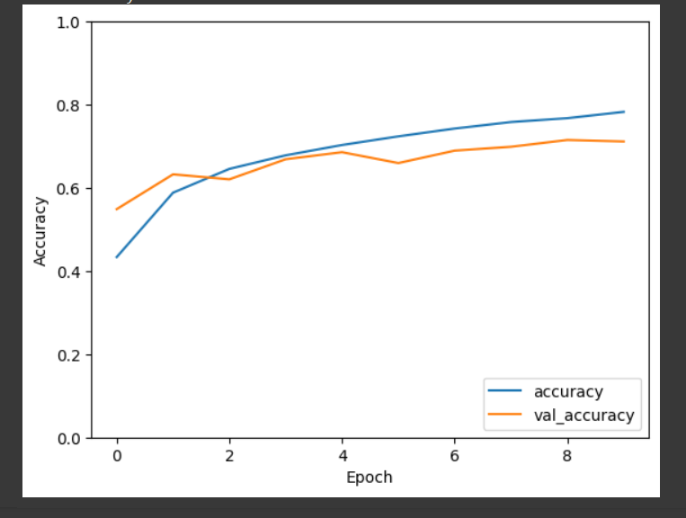
RESULTS:
The results of image recognition in deep learning include accurate classification and interpretation of images, enabling applications like facial recognition, object detection, and gesture analysis with high levels of accuracy and reliabilit

